Slide 1
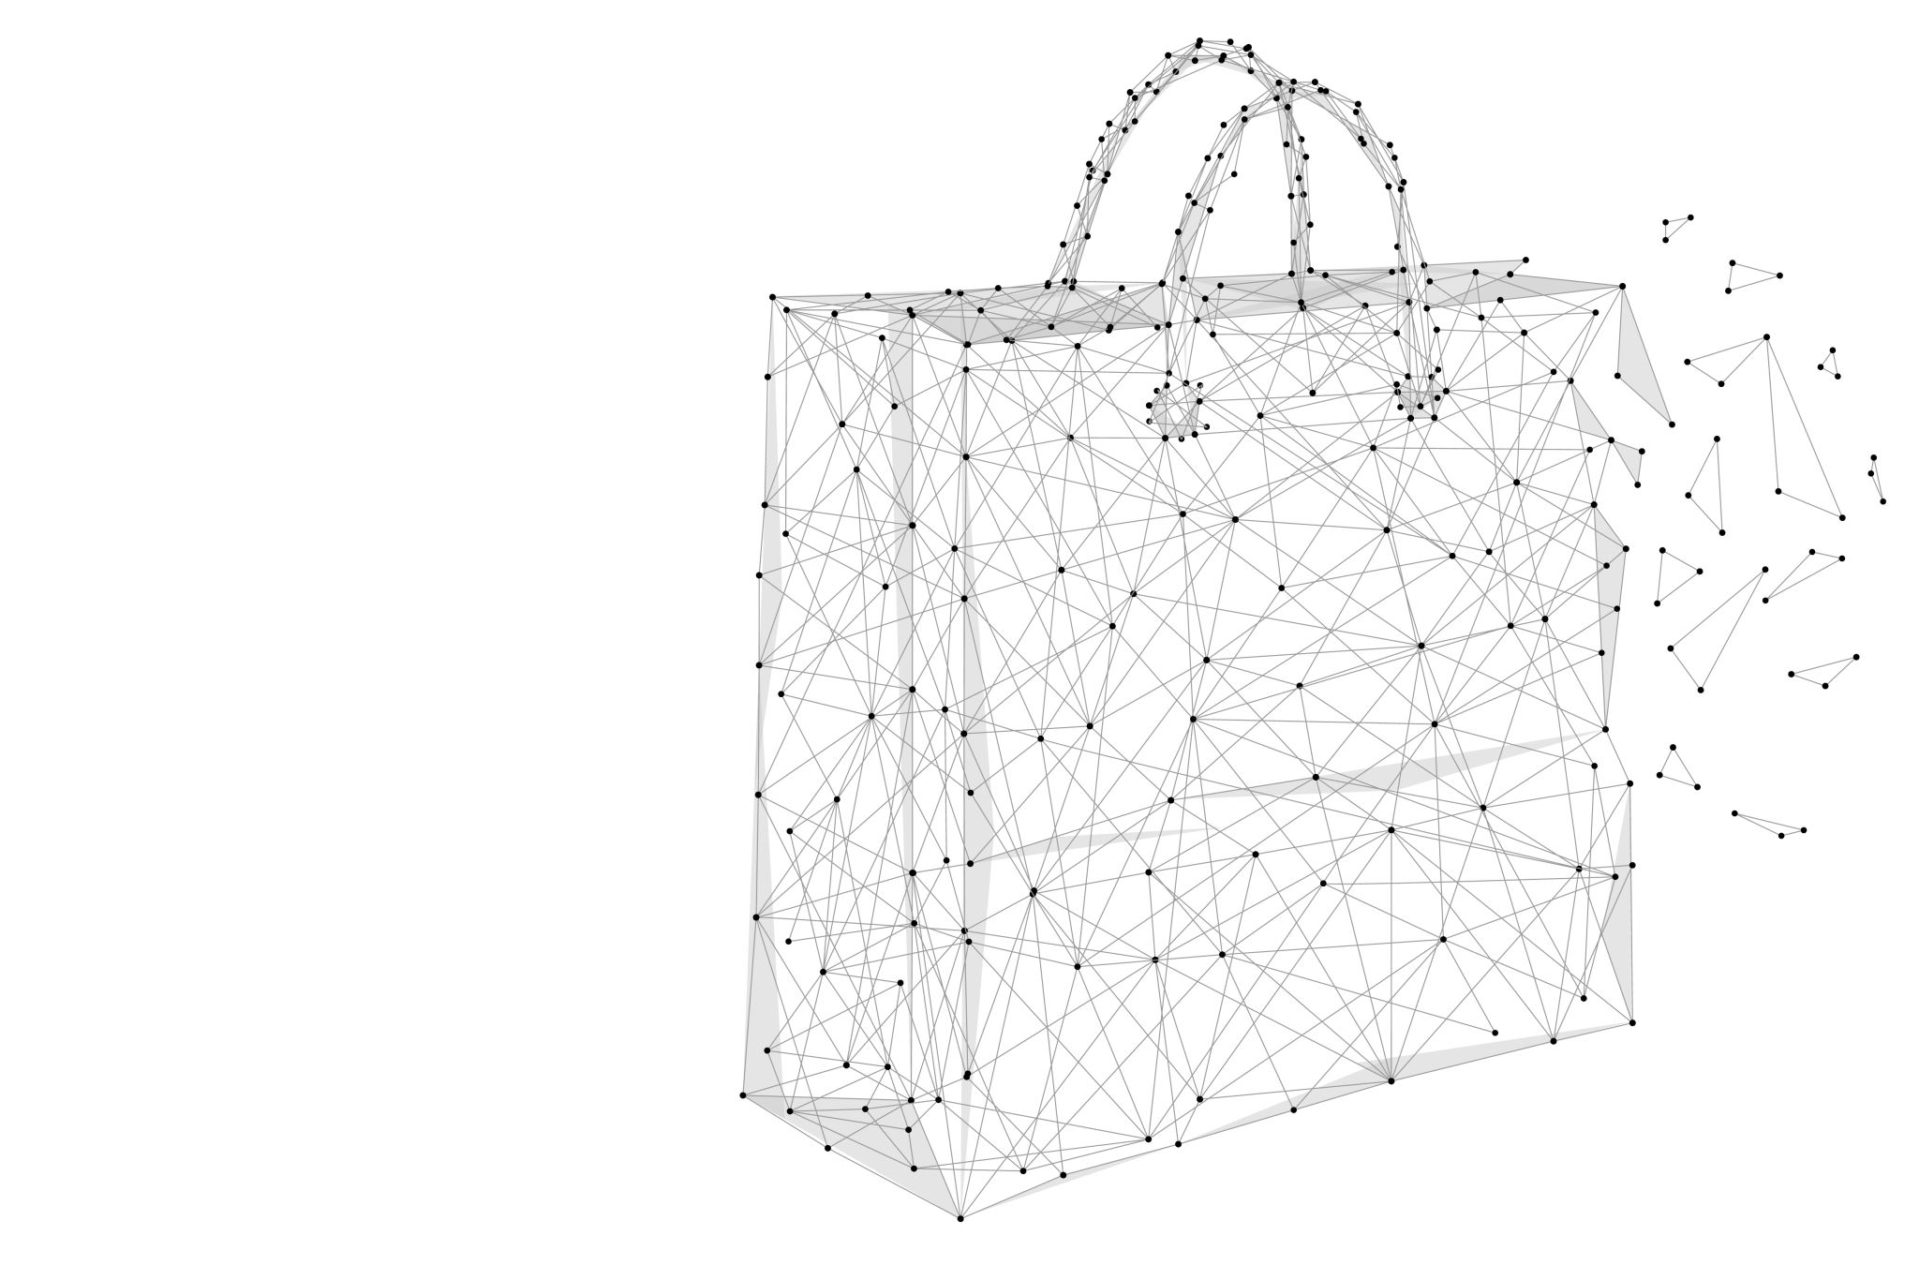
ESQUISSE PACKAGE IN R
Whats this package ?

Slide 2
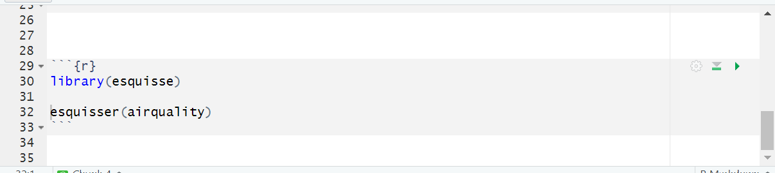
To begin

Slide 3
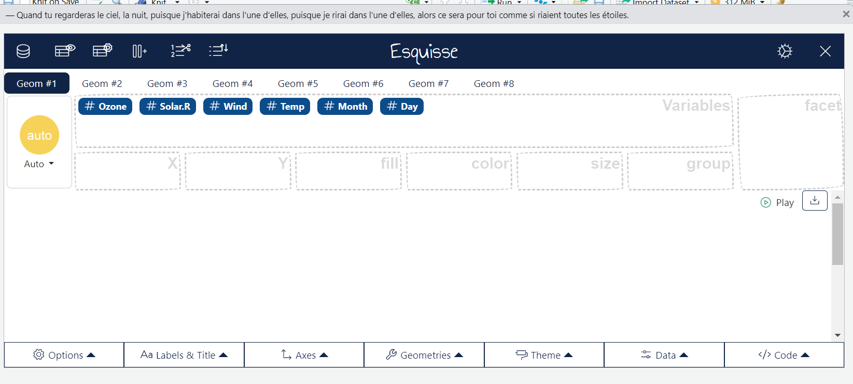
This fun box will open up
Let’s explore it

Slide 4
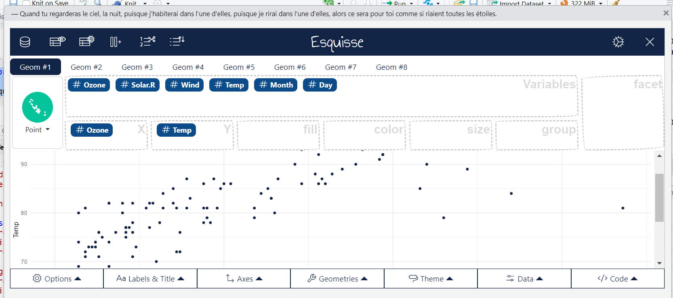
When you place values in x and y automatically the graph appears and in code you can access the code

Slide 5
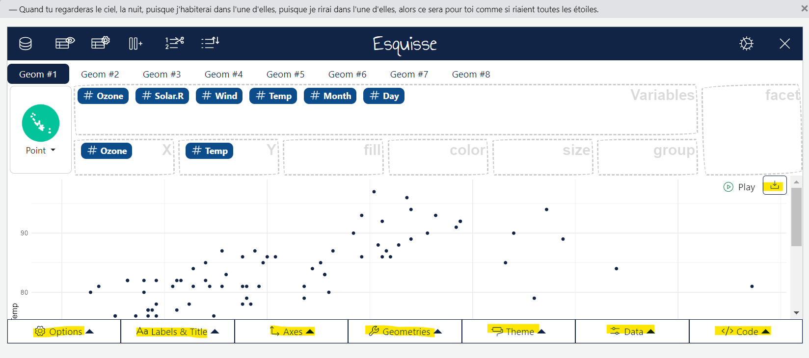
Explore
Code
Data
Theme
Geometrics
Axes
Labels and Title
Highlight download option

